Slide 1
Mission: It is the Mission of the Clark County Health Department to promote health, prevent disease, and protect the residents of the county through partnerships and population-based services. Vision: Safe environments, thriving communities, healthy people Values: Camaraderie, Connectivity, Dedication, Excellence, Ingenuity, & Integrity
Clark County Board of Health Orientation
clarkcountywi.gov/healthdepartment
facebook.com/clarkcohealthdept
Notes:
Insert photo representing your community

Slide 3
Learning Objectives
What is Public Health?
What is a Local Health Department, & Why Do They Exist?
What Are the Unique Responsibilities of a Local Health Department?
How Does a Local Health Department Carryout Services With It’s Public Health Partners?
What is a Board of Health & What Does It Do?
What Resources Are Available for Boards of Health?

Slide 4
What is Public Health?
Public Health is the science of protecting and improving the health of people and their communities.
This work is achieved by promoting healthy lifestyles, researching disease and injury prevention, and detecting, preventing, and responding to infectious diseases.
Public health systems are commonly defined as “all public, private, and voluntary entities that contribute to the delivery of essential public health services within a jurisdiction.”

Slide 5
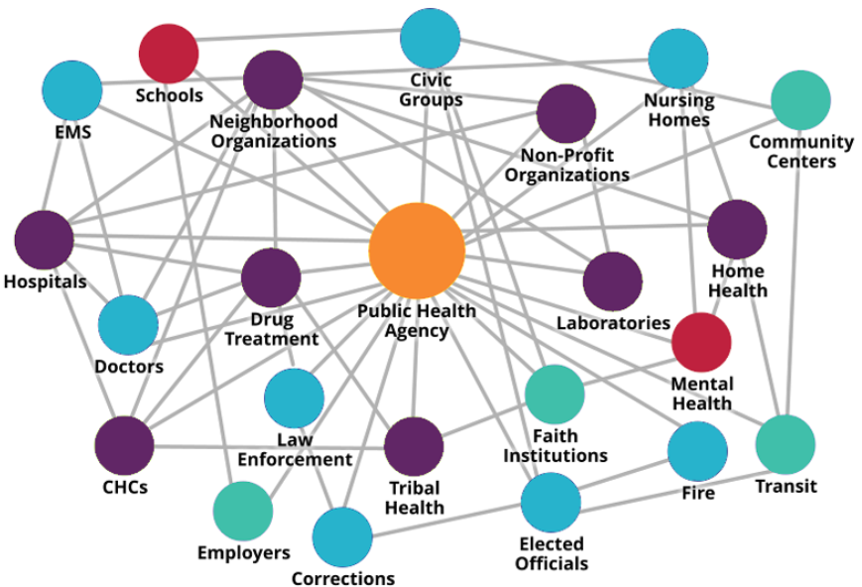
Local Health Departments Are The Center of the Local Public Health System
Responsible for the health & well-being of everyone who lives, learn, works, and plays within their jurisdiction
Prevent, protect, and promote the health & safety of communities
Provide us with a healthy community to keep us out of the doctor’s office

Slide 6
What is a Local Health Department?
Why do they exist?

Slide 7
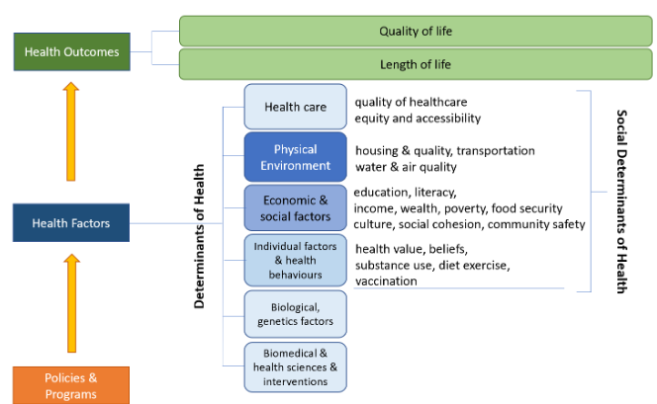
Healthy communities are important to a healthy economy.
Social and economic factors such as education, employment, income, family & social support, and community safety, influence how long and how well we live.
View Clark County’s County Health Rankings
Notes:
Note: Provide overview of the model, Share your jurisdictions’ assets and limitations based on rankings https://www.countyhealthrankings.org/explore-health-rankings

Slide 8
”Community Health Strategist”
Lead a multi-sector approach to create healthy communities, where everyone can live their best life
Prevention oriented, going up stream to prevent disease, injury, and death
Notes:
Note: Share who are public health partners in your jurisdiction

Slide 9
What Are the Unique Responsibilities of a Local Health Department?
What do they do?

Slide 10
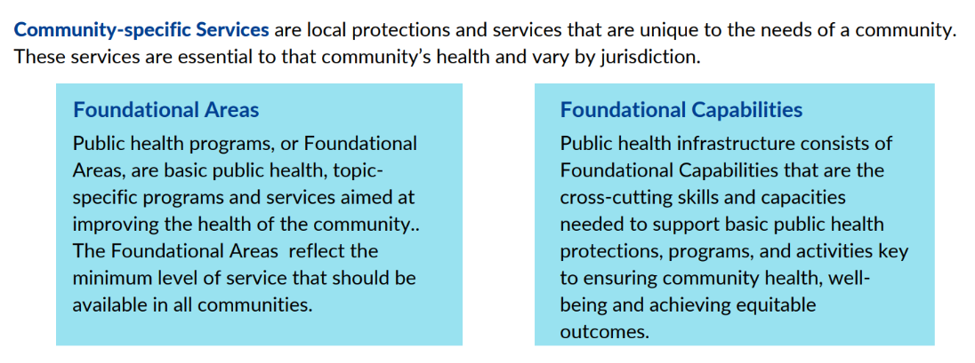
Foundational Public Health Services (FPHS)
Minimum set of public health services to be available in every community in Wisconsin and U.S.
Notes:
Note: Share examples of services provided under each foundational areas and examples of how foundational capabilities are being carried out. This can be done at this point in the presentation or after an overview of the WI statutes and administrative rules. Slide 12 was created to provide organizational chart and/or listing of services.

Slide 11
WI Statutes That Guide Local Health Departments
Statutes outline the services the public can expect from a local health department. The following Wisconsin Statutes guide local health departments:
Chapter 95: Animal Health
Chapter 250: Health, Administration and Supervision
Chapter 251: Local Health Officials
Chapter 252: Communicable Diseases
Chapter 253: Maternal and Child Health
Chapter 254: Environmental Health
Chapter 255: Chronic Disease and Injuries

Slide 12
WI Administrative Rules
DHS 140 – Required Services of Local Health Department
Revised in 2019, incorporates elements of the National Foundational Capabilities
Establishes Level of Services required for Local Health Departments
Level 1
Level 2
The Clark County Health Department is designated as a Level 2 Health Department.
Level 3
Chapter 140: Required Services of Local Health Departments
Chapter 142: Access to Vital Records
Chapter 144: Immunization of Students
Chapter 145: Control of Communicable Diseases
Chapter 146: Vaccine-Preventable Diseases

Slide 13
Clark County Ordinances
Locally, the Clark County Health Department also adheres to Clark County specific ordinances
Chapter 16: Health & Safety

Slide 14
How Does a Local Health Department Carryout Services With Their Public Health System Partners?
How do they do what they do?

Slide 15
10 Essential Services
“To protect and promote the health of all people in all communities”
Assurance
Assessment
Policy Development
1. Assess and monitor population health status, factors that influence health, and community needs & assets
2. Investigate, diagnose, and address health problems and hazards
3. Inform and educate people about health, factors that influence & how to improve it
4. Mobilize communities and partnerships
5. Create, champion & implement policies, plans, and laws
6. Use legal and regulatory actions designed to improve and protect
7. Assure effective systems enables equitable access to services and care
8. Build & support diverse & skilled workforce
9. Improve & innovate through ongoing evaluation, research, and QI
10. Build & maintain strong organizational infrastructure
Notes:
Note: Share examples of how essential services look within your jurisdiction.

Slide 16
Public Health Standards
WI DHS 140 Review
National Public Health Accreditation
Confirms a local health department meets requirements for Level 1, Level 2, or Level 3
Conducted every 5 years
Standards in carrying out the 10 Essential Public Health Services
Demonstrates ability to meet national standard to carry out quality governmental public health services
Pathways Recognition Program
Accreditation
Notes:
Note: Share what the level of your health department, why that level was chosen, by whom and when. Given an overview of the different expectations for each level and/or share a copy of the DHS 140 rule. Share when a 140 review was conducted and the findings/ recommendations.
Share where your health department is being ready or accredited and background information for the current status.

Slide 17
What is a Board of Health?
What does it do?

Slide 18
What is a Board of Health in WI?
Governing body for a local health department
Governance varies across Wisconsin
Currently 85 local health departments
County, multi-county, city-county, city, village, and multi-city/village
Wisconsin Statute Chapter 251.03 Membership
No more than 9 members
At least 3 members not elected officials
Good faith effort to appoint RN and physician, allowing to appoint physician assistant, advance practice RN, or both, if unable to find
Reflect the diversity of the community
Notes:
Notes: Share ordinance, rules, or bylaws for the Board of Health that cover membership, meeting frequency, etc. Discuss what governance looks like (advisory, policy setting) and who they report to.

Slide 19
What does a Board of Health do?
Wisconsin Statute Chapter 251.04 outlines powers and duties:
Govern the local health department
Assure the local health department is a Level I, Level 2, or Level 3
May adopt regulations for its own guidance and for the governance of the local health department necessary to protect and improve public health. Report to the state department by rule
Meet at least quarterly
Notes:
Notes: Share how powers and duties look like for your jurisdiction based on the governance structure and reporting relationships.

Slide 20
What Does a Board of Health Do? (continued)
Assess public health needs and advocate for the provision of reasonable and necessary public health services
Develop policy and provide leadership that fosters local involvement and commitment that emphasizes public health needs and that advocates for equitable distribution of public health resources
Assure measures are taken to provide an environment in which individuals can be healthy
hall employ qualified public health professionals

Slide 21
Board of Health Resources-Associations
Wisconsin Association of Local Health Departments and Boards (WALHDAB)
Wisconsin Public Health Association (WPHA)
National Association of Local Boards of Health (NALBOH)
National Association of County and City Health Officials (NACCHO)
American Public Health Association (APHA)
Notes:
Note: Share resources as appropriate.

Slide 22
Board of Health Resources (continued)
Board of Health Proceedings
Can subscribe to receive notifications
WI Department of Health Services
Healthy People 2030
WI State Health Plan
County Health Rankings
Clark County Health Department Publications & Data
2023 Annual Report
2023 Mortality Surveillance & Injury Related Health Outcomes
2023-2025 Community Health Assessment (CHA) & Community Health Improvement Plan (CHIP)
2024-2026 Strategic Plan
Notes:
Note: Share resources as appropriate.

Slide 23
Conclusion-What is Health?
Health is living long and well
It’s where we live, work, learn, and play
It’s opportunity—for all of us—to strive and thrive
Notes:
Note: Emphasis the value and importance of BOH in supporting local health department’s unique responsibilities. The End!

